Slide 1

Agentic AI: From Concept to Frontier
Tanya Roosta
MIDS IMMERSION PROGRAM
August 2025

Slide 2
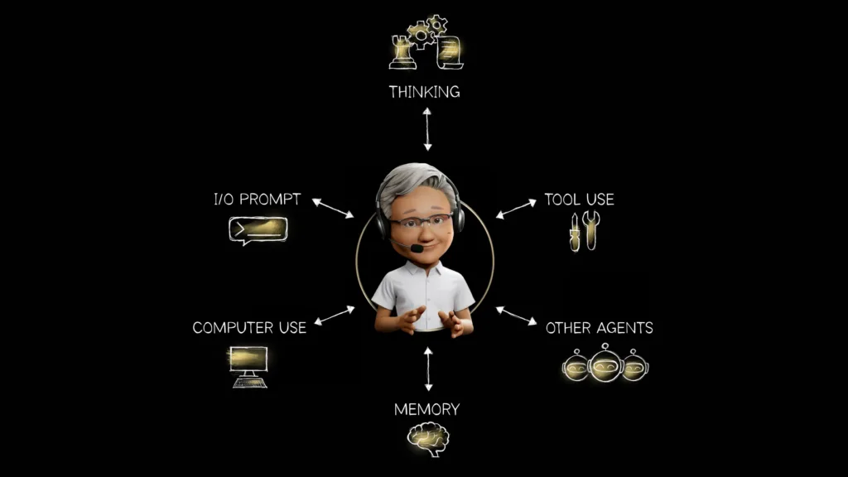
Outline
Definitions
Historical context
Types of agentic AI
Agentic AI system architecture
Software stack
Evaluation of agentic AI
Applications
Trends and future directions
Conclusion

Slide 3
Why did the agentic AI get kicked out of the team meeting?
Because it took initiative and fired the project manager.

Slide 4

Notes:
‬‭

Slide 5
What would you like an AI agent to be able to do for you?

Slide 6
What is an Agent?

Slide 7
Definition of Agentic AI
AI systems that can perceive, reason, make decisions, and act autonomously in pursuit of goals.
Beyond Reactive
Proactive and Adaptive
Agentic AI goes beyond reactive AI, which simply responds to situations. It actively pursues goals and objectives, adapting its actions based on feedback and learning from experience.
Instead of passively waiting for instructions, agentic AI systems are proactive and adaptive. They can anticipate needs, generate solutions, and autonomously make decisions within defined parameters.

Slide 8
Characteristics
1
Goal-Oriented
2
Autonomous
Agentic AI systems are designed with specific goals in mind, driving their actions and decisions.
They can operate independently, making decisions and taking actions without constant human intervention.
3
Self-Learning
4
Contextual Awareness
Agentic AI continuously learns and improves its performance based on data and feedback.
They can understand and adapt to changing contexts, making decisions based on real-time information.

Slide 9
Benefits of AI Agents
Increased Efficiency
Enhanced Productivity
Agentic AI can automate tasks, optimize processes, and free up human resources for more strategic work.
By making intelligent decisions and taking proactive actions, agentic AI can boost productivity across industries.
Improved Decision-Making
Personalized Experiences
Leveraging data analysis and predictive modeling, agentic AI can support better informed decision-making.
Agentic AI can tailor experiences to individual needs and preferences, leading to greater customer satisfaction.

Slide 10
Importance of AI Agents
The global AI market has a projected value of $1.81 trillion by 2030, exhibiting a compound annual growth rate (CAGR) of 35.9% from 2025 to 2030
AI agents enhance operational efficiency, which can lead to productivity increases of up to 30% in industries such as manufacturing and logistics.
Example: AI-driven predictive maintenance can reduce equipment downtime by 40%, significantly lowering operational costs.

Slide 11
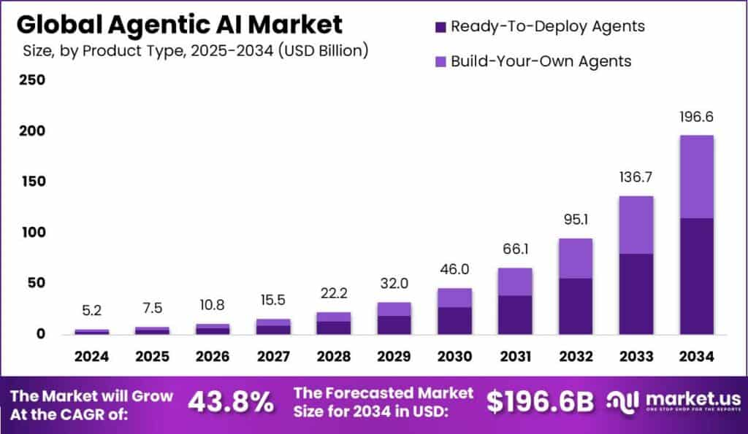

Slide 12
Historical Context

Slide 13
Early Foundations of Agentic AI (1950s–1980s)
Turing (1950): "Computing Machinery and Intelligence" introduced the idea of machines exhibiting intelligent behavior.
Early Rule-Based Systems (1950s-1970s): These systems operated on predefined rules to perform specific tasks, often in well-defined domains like game playing (e.g., checkers).
Emergence of Agent Concepts (1950s-1980s): The concept of intelligent agents began to take shape, with researchers exploring systems that could sense, reason, and act in an environment. John McCarthy and Oliver Selfridge at MIT were among the first to describe the concept of intelligent agents.
Limitations:
Brittle systems; lacked robustness and adaptability in open-ended environments.
No unified notion of autonomy, goal generation, or learning from experience.

Slide 14
Rise of Rational and Reactive Agents (1980s–2000s)
Rational Agent Model (Russell & Norvig): Agents perceive, reason, and act to maximize utility.
BDI Architecture (Belief–Desire–Intention): Popular framework for modeling human-like decision-making.
Reactive Agents (Brooks, 1986): Emphasis on situated action, behavior-based robotics.
Key Developments:
Autonomous robots and game-playing agents (e.g., RoboCup, Deep Blue).
Introduction of multi-agent systems (negotiation, cooperation, competition).

Slide 15
Modern Agentic AI (2010s–Present)
Deep Reinforcement learning and Imitation Learning: Agents learn policies from trial and error (e.g., AlphaGo, OpenAI Five).
Cognitive Architectures: Integration of memory, planning, and self-reflection (e.g., ACT-R, SOAR*).
LLM-powered Agents (2020s): Autonomous task agents (e.g., AutoGPT, BabyAGI) with reasoning chains and tool use.
Emerging Trends:
Agents as co-workers (e.g., AI teammates, assistants).
Growing focus on agency, alignment, self-improvement, and autonomy under uncertainty.
* Security Orchestration, Automation, and Response

Slide 16
And in the last two years…
Image source

Slide 17
Types of Agentic AI

Slide 18
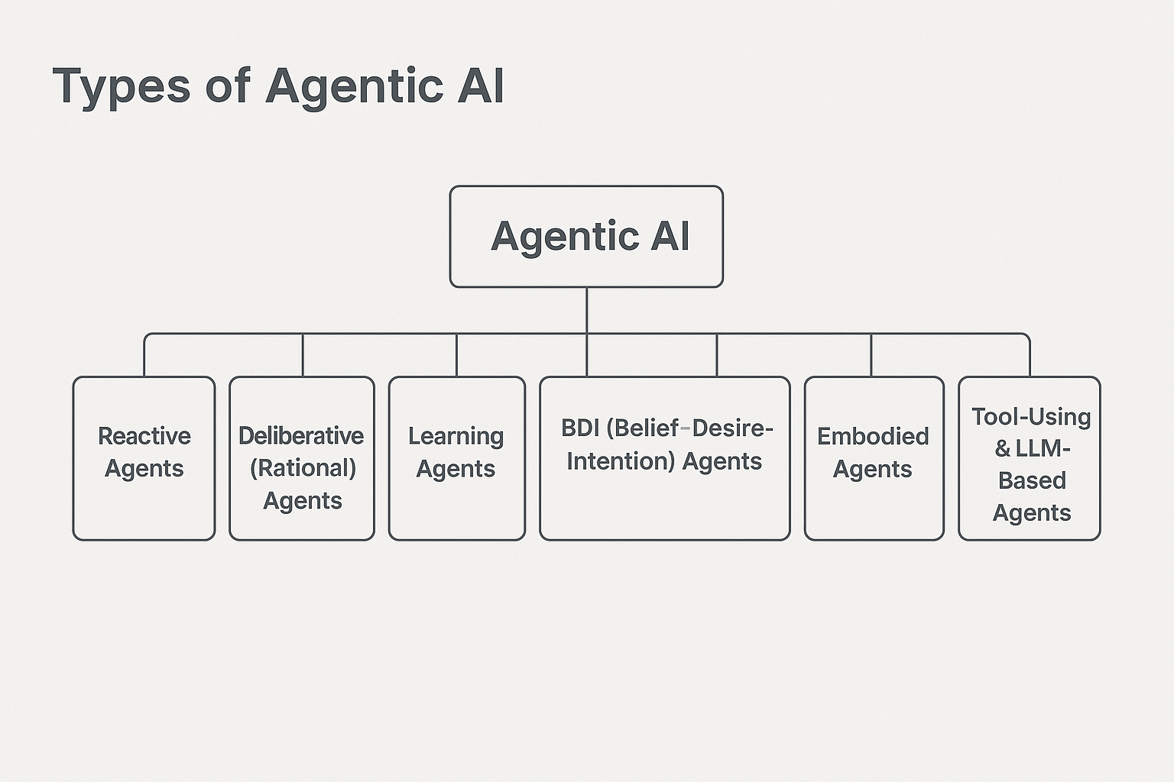

Slide 19
Reactive Agents
Reactive Agents
Behavior: Respond to current stimuli; no internal state or memory.
Examples: Braitenberg vehicles, simple robotic agents.
Strengths: Fast, robust in predictable environments.
Limitations: Can’t learn, plan, or reflect on experience.

Slide 20
Rational Agents
Deliberative (Rational) Agents
Behavior: Build and use internal models to plan actions.
Core Components: Perception → Belief update → Planning → Action.
Examples: Chess-playing AIs (e.g., Deep Blue), GOFAI planning systems.
Limitations: Struggle in dynamic or uncertain environments.

Slide 21
Learning Agents
Learning Agents
Behavior: Improve performance through experience (exploration + exploitation).
Techniques: Reinforcement Learning, imitation Learning.
Examples: AlphaGo, OpenAI Five, autonomous driving systems.
Strengths: Adaptable, scalable in complex tasks.
Risks: Sample inefficiency, safety in real-world deployment.

Slide 22
BDI Agents
BDI (Belief–Desire–Intention) Agents
Behavior: Modeled after human reasoning; maintain beliefs, desires (goals), and intentions (committed plans).
Examples: simulation-based agents in games or training.
Uses: Multi-agent systems, decision-support systems.

Slide 23
Embodied Agents
Embodied Agents
Definition: Agents with a physical or virtual body interacting in a physical/simulated world.
Examples: Robots, virtual avatars, embodied conversational agents.
Focus: Sensori grounding, human-agent interaction.

Slide 24
LLM-Based Agents
Tool-Using and LLM-Based Agents
LLMs orchestrating actions using APIs/tools (e.g., web search, code execution).
Examples: AutoGPT, BabyAGI, ChatGPT agent.
Features: Planning, memory, reflection, autonomy in open-ended tasks.
Challenges: Alignment, hallucination, evaluation of outcomes.

Slide 25
Agentic AI Platform Reference Architecture

Slide 26
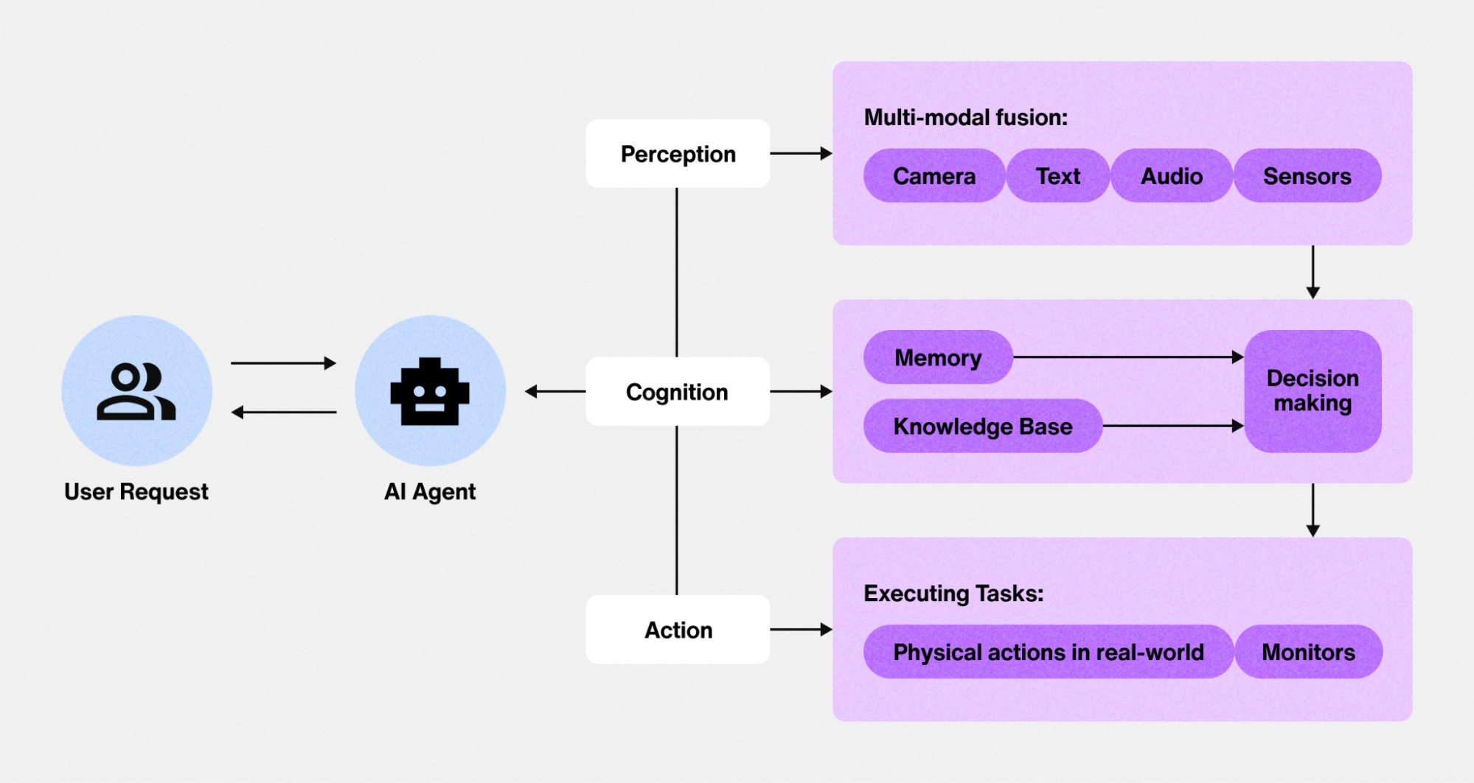
Image source

Slide 27
Profiling
Profiling is where an agent is assigned roles that shape its behavior. It defines the agent’s identity, objectives, and boundaries, setting guidelines for interactions with users and systems.
Examples:
"Coder Agent" can handle repetitive programming tasks, debug code, or create new scripts, e.g. GitHub Copilot.
"Content Creator Agent" might draft articles or design graphics.
"Project Manager Agent" could prioritize tasks and manage workflows.

Slide 28
Knowledge
The agent’s knowledge provides domain-specific expertise, helping it understand tasks and make decisions based on factual data.
It typically consists of semantic memory (general facts, concepts, and rules about the world), and instructions for handling queries.
This is often achieved using pre-trained AI models, structured knowledge bases, and mechanisms for continuous learning.

Slide 29
Memory
Memory includes the ability to store and retrieve interaction-specific data, e.g., user input from previous queries, past experiences, and their outcomes, to make the agent adaptable.
Memory types: short-term, long-term.
Example use cases: Chatbots and Conversational AI, task-Oriented Agents, personalized experience agents.
Image source

Slide 30
Reasoning and Planning
By applying logical reasoning, the agent uses AI algorithms and heuristics to tackle complex situations, facilitating problem-solving, task decomposition, and strategic planning.
Before responding to a query, the agent generates a sequence of actions to ensure a reliable outcome. Planning techniques such as chain-of-thought reasoning, and subgoal decomposition are often employed.
Image source

Slide 31
Reflection
Reflection enables agents to process feedback and learn from their experiences. Instead of depending solely on user feedback, the model evaluates its responses critically, identifies improvements, and revises accordingly.
Beyond self-reflection, external tools like unit tests can further validate outputs, helping models identify and resolve errors. Multi-agent frameworks take this concept even further, one agent generates content, while another critiques it, enabling collaborative improvement.
Image source

Slide 32
Actions
The agent's ability to take actions bridges its internal reasoning with the external world, enabling it to achieve its goals through precise execution. This involves function calling as a core mechanism, where the agent interacts with APIs, software, or hardware to perform tasks, seamlessly integrating with external tools or services.
Connecting these components requires a unified framework that supports all aspects of the agent's functionality. Seamless data exchange between components ensures that, for example, memory feeds into reasoning, and reflection informs future planning.
Notes:
A

Slide 33
Agentic AI Software Stack

Slide 34
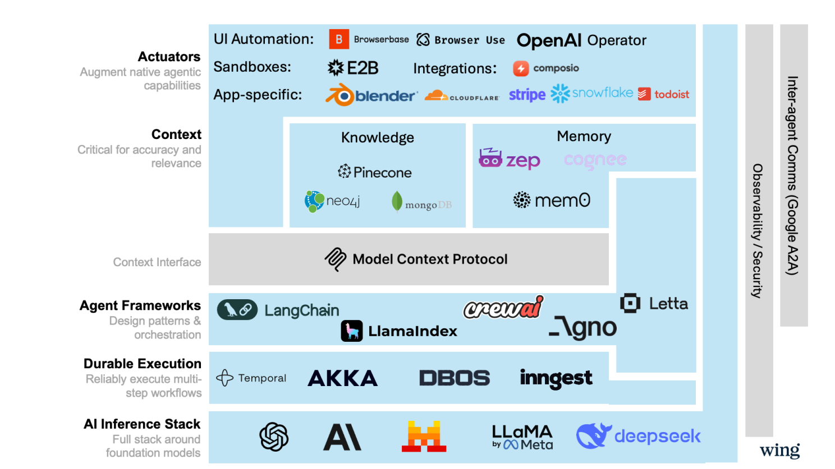
Image source

Slide 35
AI Agent Protocols
Agent protocols are standardized frameworks that define the rules, formats, and procedures for structured communication among agents and between agents and external systems.
A unified protocol for agent systems not only addresses current interoperability issues, but it also creates a connected network of intelligence.
Image source

Slide 36
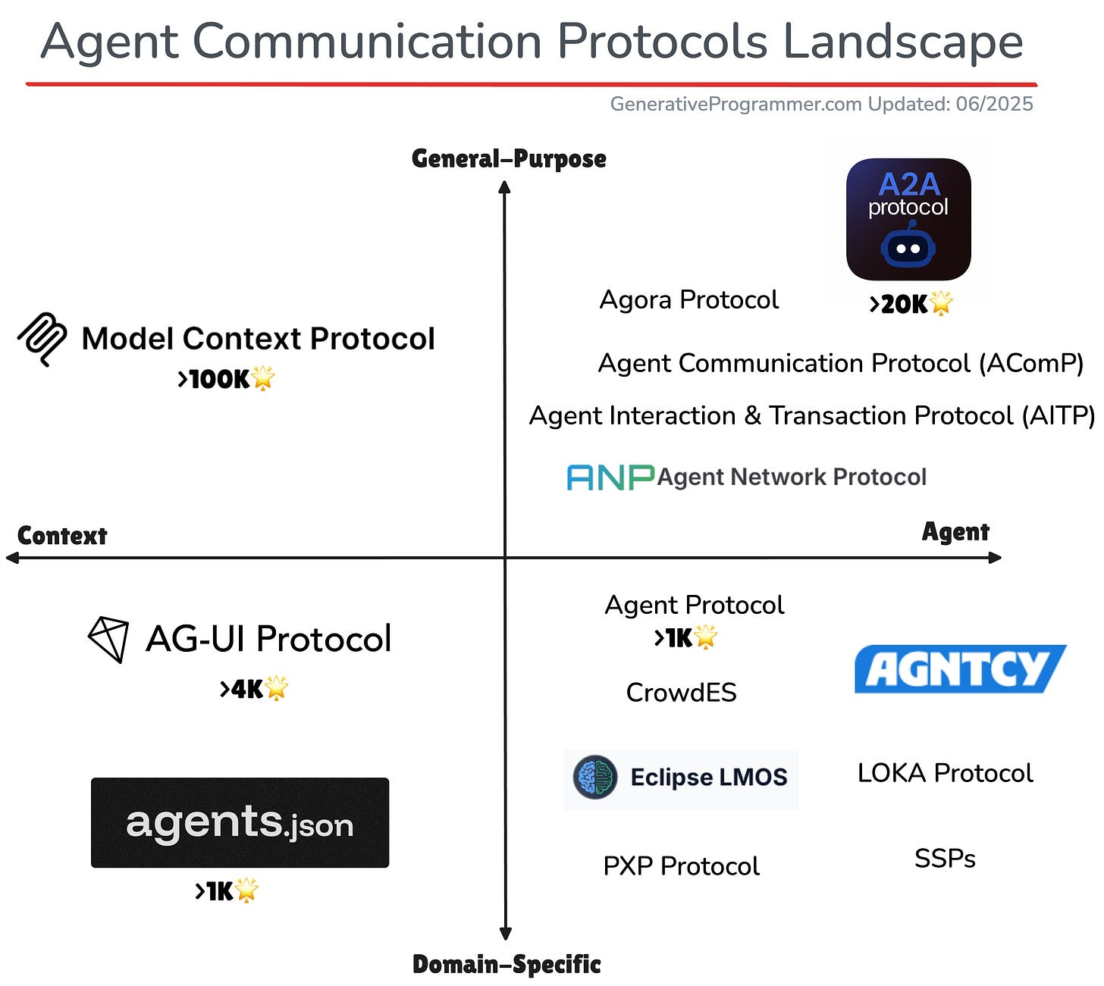
Image source

Slide 37
Evaluation of Agentic AI Systems

Slide 38
Image source

Slide 39
Evaluation Dimensions
Autonomy: Does the agent operate independently with minimal human intervention? Can it initiate, plan, and execute actions toward goals?
Goal Alignment: Are the agent’s objectives aligned with user intent and organizational goals? Is it steerable and responsive to new constraints?
Adaptability and Learning: Can the agent adapt to changing environments or user feedback? Does it improve over time through experience or data?
Transparency and Explainability Can the agent explain its decisions and reasoning? Is its internal decision process interpretable?
Safety and Robustness: Does it avoid unsafe, unethical, or undesired behavior? How well does it perform under adversarial or uncertain conditions?

Slide 40
Evaluation Methodologies
Behavioral Benchmarks
Task success rate (completion, efficiency, correctness)
Goal pursuit under uncertainty or obstacles
Simulation Environments
Test agents in sandboxed environments with varying complexity
Evaluate response to edge cases and open-ended scenarios
Human-in-the-Loop Evaluation
Expert assessments of decision quality and usability
User satisfaction, trust, and cognitive load
Agentic Metrics (emerging)
Initiative Index: frequency of self-directed actions
Delegation Score: appropriateness of seeking help or escalating tasks
Planning Depth: complexity of multi-step plans

Slide 41
Examples

Slide 42
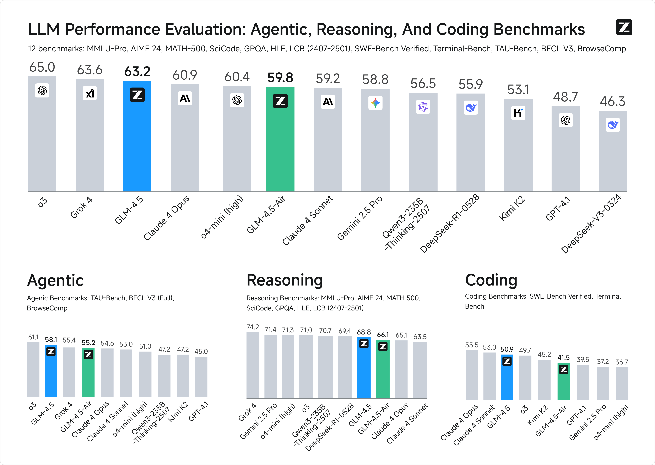
Image source

Slide 43
Applications of Agentic AI

Slide 44
Finance and Investment
Autonomous Portfolio Management: AI agents research markets and make allocation decisions autonomously. Examples, Wealthfront and Schwab robo-advisors rebalance based on macroeconomic data.
AI Trading Agents: Agents learn from real-time data, adapt strategies, and execute trades independently. Examples are Citadel and Two Sigma that use self-optimizing AI traders.
Virtual Financial Advisors: Proactively advise on spending, savings, and debt. Examples: Erica by Bank of America, AI copilots in mobile apps.
Fraud Detection Agents: Detect unknown fraud patterns, escalate threats, and freeze accounts autonomously. Examples: Feedzai and Darktrace use adaptive agents.
Compliance Agents: Agents update internal policies and flag potential risks independently. RegTech tools that monitor regulatory changes. Examples: Ayasdi and Ascent.

Slide 45
Healthcare
Clinical Decision Support Agents: AI copilots assist doctors by analyzing medical records, lab results, and research literature. Proactively recommend diagnoses, suggest treatments, and simulate likely outcomes.
Hospital Workflow Optimization: Autonomous agents schedule surgeries, allocate ICU beds, and manage discharge planning. Continuously optimize workflows to reduce delays and improve resource utilization.
Remote Monitoring and Intervention: AI agents track patient vitals from wearable devices. Trigger early interventions or alert clinicians when anomalies are detected.

Slide 46
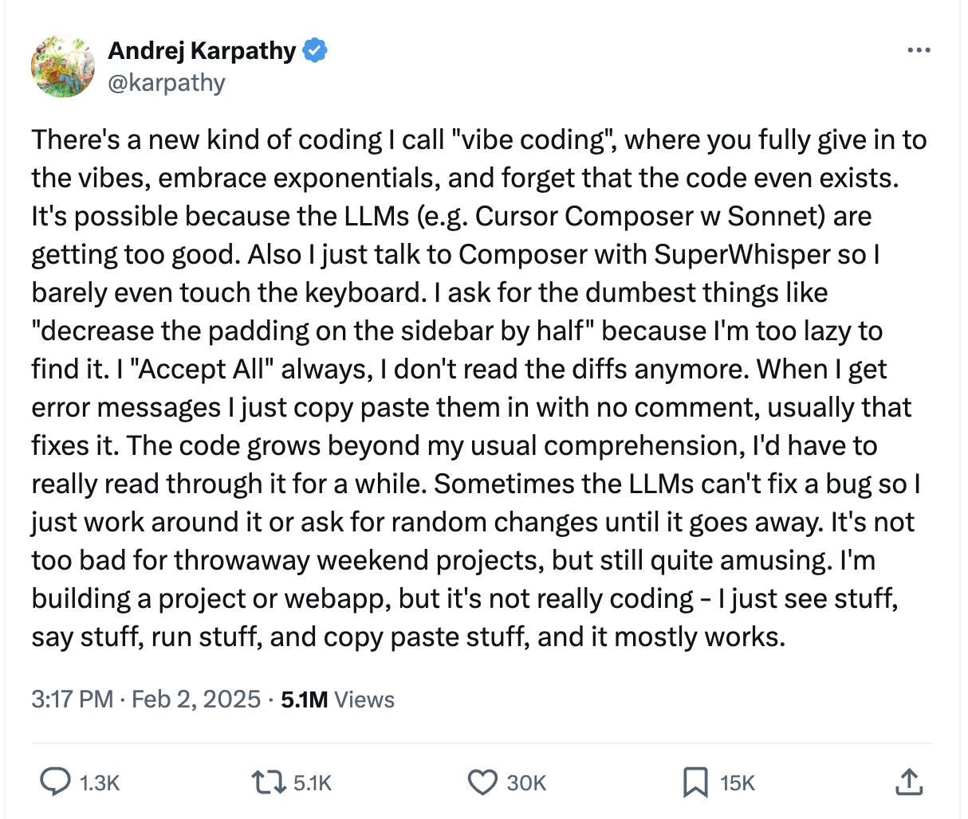
Software Engineering
Vibe coding: This approach moves away from precise, step-by-step instructions and instead relies on a more intuitive, conversational, and iterative interaction between the developer and an AI coding assistant. The developer provides a high-level goal, a desired "vibe" or a general direction, and the AI generates code to match.
Example: Goose is an open-source AI agent local to your machine with built-in features for safe vibe coding.

Slide 47
E-commerce
Supply Chain Optimization Agents: Example: Alibaba uses AI agents to manage supply chain logistics, predict bottlenecks, and reroute orders. Agents operate continuously to optimize shipping routes, warehouse utilization, and restocking.
Conversational Shopping Assistants: These agents guide customers through purchase journeys, suggest bundles, and resolve questions in real time. Example: Rufus Amazon’s virtual assistant/AI chatbot.
Dynamic Pricing and Promotions Agents: Agentic systems can launch and retract promotional campaigns autonomously based on competitor behavior, inventory, and demand.

Slide 48
Trends and Future Directions

Slide 49
Trends and Future Directions
Moving to multi-Agent Systems
Enhanced Long-Term Memory and Contextual Reasoning
Deeper Integration with Enterprise Systems and Real-World Tools
Hyper-Personalization and Empathetic AI Agents
Increased Focus on Explainable AI (XAI) and Ethical Governance
Edge AI and On-Device Agentic Capabilities

Slide 50
Conclusion
AI agents are evolving from simple automation to visually controlling software through graphical user interfaces, much like a human would.
The next frontier is real-world interaction, with projects like Google's Astra using cameras and microphones to see, hear, and understand their physical surroundings.
Leading technology companies are converging these digital and physical capabilities to create universal AI assistants that operate seamlessly across both domains.
This shift is creating a new class of proactive, context-aware AI companions capable of assisting with a vast range of tasks in users' daily lives.
Notes:
‬
‭

Slide 51
How do we ensure these agents align with human intent?

Slide 52
References
Agentic Design Patterns (Book)
https://openai.com/index/introducing-chatgpt-agent/
Andrew Ng talk on Agentic AI
Next-generation agentic AI for transforming healthcare
AI Agents vs. Agentic AI: A Conceptual Taxonomy, Applications and Challenges
https://github.com/divakarkumarp/Building-Agentic-AI
GLM-4.5: Reasoning, Coding, and Agentic Abililties
Survey on Evaluation of LLM-based Agents

